Slide 1
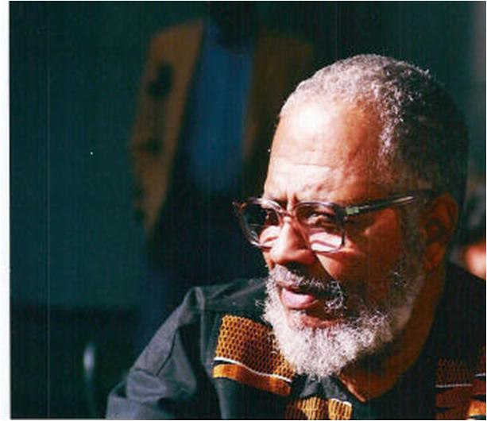
Intellectual Warfare, Fugitive Black Study and Institutionalizing Education for Self-Determination: Orientation and Problems
The Jacob H. Carruthers, Jr. Conference
The Jacob H. Carruthers, Center for Inner City Studies
Northeastern Illinois University
Chicago, IL
February 15, 2014

Slide 2
The Occasion
2014 marks the thirtieth anniversary of the publication of “Essays in Ancient Egyptian Studies,” three essays documenting the emergence of the Kemetic Institute. Jacob Carruthers’s admonition in the first of these essays, “Orientation and Problems in the Redemption of Ancient Egypt,” gives us a point of departure for considering basic challenges of Intellectual Warfare and Fugitive Black Study facing African people.

Slide 3
Charts
The Occasion: The 30th Anniversary of Essays in Ancient Egyptian Studies and the Emergence of the Kemetic Institute
CICS and KI: Founding Moments: Fugitive Black Study
Orientations and Problems in the Redemption of Ancient Egypt
The Directives: A Sebayt

Slide 4
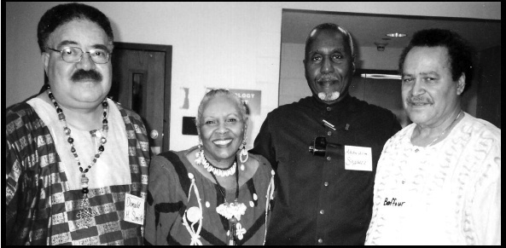
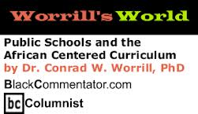
“Fugitive Black Study”: A Working Definition
K-12: Training Teachers for Fugitive Black Study
Ground Rules for Intellectual Work, Framing Questions and Conceptual Categories
“Post-Secondary” Education: Autonomy, Licensure and Fugitive Black Study
In the classroom: individuals and clusters
In the institution: academic administrative units

Slide 5
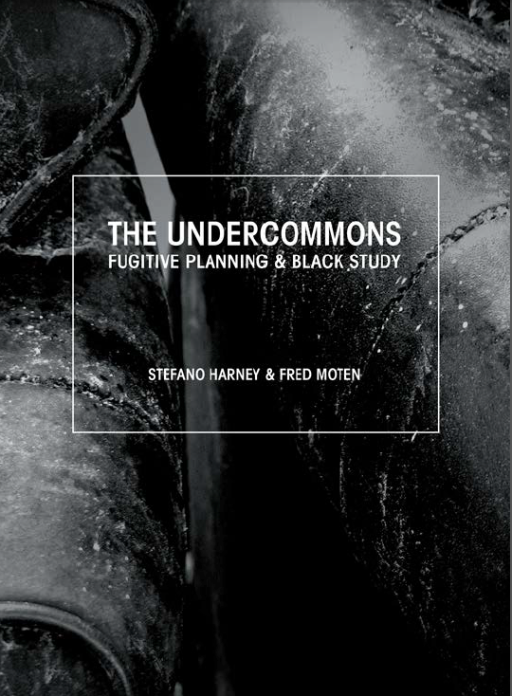
The Centrality of CICS
The Question of “Inner City” Studies as “Black Study” in “The Undercommons”
The University and the Undercommons
The Nomenclature of “Inner City Studies”
1966: A Discipline States its Case
Carruthers, “Reflections on the Discipline of Inner City Studies”
Institutionalized African-Centered Subversion:
Curriculum Development
Educator Training
Shaping and Influencing Institutions, Ideas and Agendas
Public and Private
Human and Social Service Agencies
Mutually-Reinforcing and Protectivel Institutions
The Caucus Moment: AHSA (ASA), ABPsi (APA), NABSW, etc.
The Self-Determining Institutions Moment : KI, ASCAC, CIBi, etc.

Slide 6
Some Lessons Learned for African-Centered Education
Formalizing Pan-African Structural Linkages to Maintain Truces
The challenges of ideology
The challenges of training and licensure
The challenges of resources
Strengthening Existing Liberated Educational Spaces and Networks
KI, ASCAC (and affiliated study groups/organizations), CIBI, NABSE, ABSW, et. al.
Build Without Ceasing: Fugitive Black Study
Teaching and Learning Training
Innovations in Curriculum and Instruction
Frist Tasks: “Breaking the Chain” [Orientation and Problems]

Slide 7
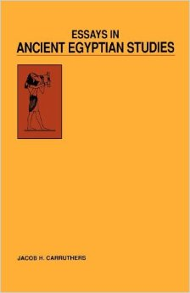
Orientation and Problems
30th Anniversary of Essays
Lecture One: Orientation and Problems
The question of “Orientation”
Six Methodological Problems

Slide 8
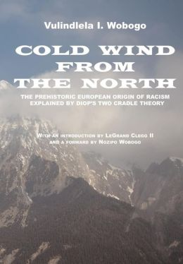
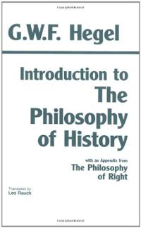
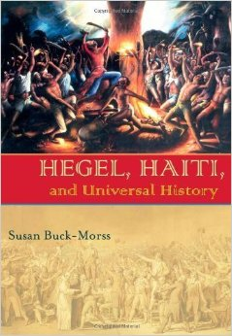
Problem 1: The Value of the Two Cradle Theory to the Establishment of the African Worldview
Accepts Diop’s general premise: The multivalent development of human societies
Accepting the concept of the autonomous bases for human development negates the “sequential development” thesis at the heart of Western World History.

Slide 9
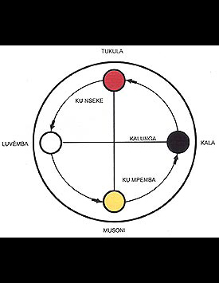
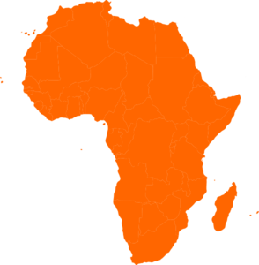
Problem 2: The Problem of Spatial Conceptions to the Construction
mhtt
North
Down
Delinking human orientation from natural orientation. Left, Right, Up and Down
(Re)contextualizing the Cosmogram
Restoring the “Dear Old Southland”: A Radical Act of Black Study
i3bt
imnty
East
Left
West
Right
South
Up
hnty

Slide 10
Problem 3: The Importance of the Linguistic Context
“Of course, learning the language poses a number of problems and, more importantly, opportunities. After one has acquired the grammatical and vocabulary skills, which is about as far as the Egyptologists have gone, the frontier of Black research is in the dramatic meanings beneath the formal and obvious meanings. Here is an area where Black intellectuals with knowledge of African languages and Black culture can find messages which are hidden in the subtleties of the language. The whole meaning of the word plays [puns] and the symbolic significance of the language signs are still largely mysteries to the European experts.” [Essays, p. 26, emphasis added].

Slide 11
Some Problematics of Translation
“Mastered and known”/”Intuited and Sensed”: The interstices [breaks] of “dramatic readings”
Black Study: The creation of governance/internal rules: “…the frontier of Black research is in the dramatic readings beneath the formal and obvious readings.”
The value of primary sources: They help us establish a relational dynamic between what we have been socialized to believe is the “sequential development” of human society and what Fred Moten might call the "anoriginary drive," or "transformative impositions" that create (reveal?) regulation, that "bring regulation into existence.”

Slide 12
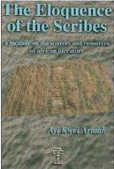
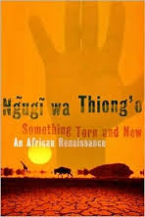
Problemmatics, Cont’d
The question becomes whether our acts of translation reveal original regulation or whether they establish anoriginal ones. What is the power (debt and surplus) of value assigned to prior experience and knowledge? How does a " fugitive" black community govern itself accordingly? These are questions of character-in-group, of revealed meanings that re-inscribe, explain or otherwise set relational dynamics between groups (the presuppositions that lie back of critical race theory, for example).
The continuing search--black study--is for the unifying continuity of inquiry. Carruthers identities the mdw Ntr as the first language capable of scholarly inquiry. Is there a continuing whole (the cultural unity/worldview thesis)?

Slide 13
Problem 4: Language and Kemetic Indentification
Affirm identity
Show respect for Ancestors
The constant state of Mdw Ntr over three millennia: “The authority of correctness,” or “the fixed figure.”

Slide 14
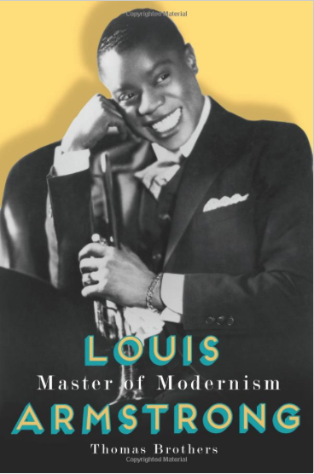
A Fixed and Variable Model for “Dramatic Readings”
The “fixed and variable” model:
Grounding Instrument/Theme: A repeated thematic/rhythmic figure [Orients the listener/interpreter]
Variable (intervening) Instrument/Theme: Departs from the repeated figure in interesting ways.
Misinterpreted as strictly polymetered instead of obeying a rhythmic hierarchy [regulation]
“The implications of this line of analysis are startling: by making the fixed and variable model so central to his music, Armstrong intensified the audible presence of his African heritage. Brothers, p. 8

Slide 15
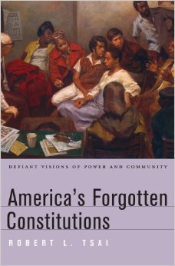
Fixed and Variable: Naming as an act of “Transformational Imposition”
Essays: Naming [Fixed Practice]
Kemet
Nehesi
Semantic Translation/Variable: The naming of places
Banneker, Tubman, Allen, et. al.

Slide 16
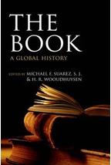
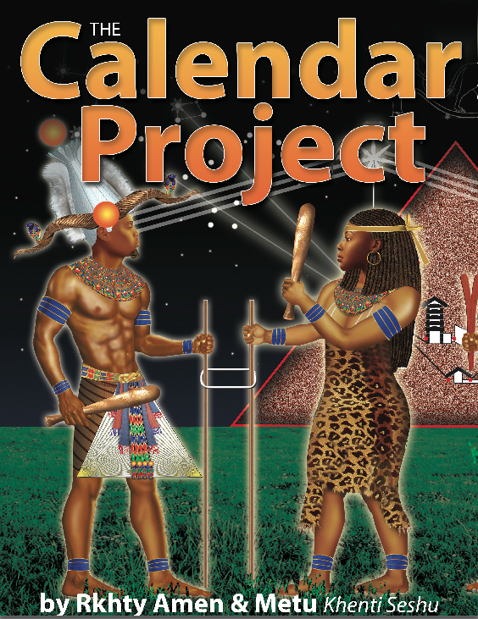
Problem 5: Problems of Chronological Perspective
Carruthers considers the intellectual genealogy of the European dating system for Kemet.
Becomes a framework for all other assumptions about non-European life
The evocation of AFK (or SM as Carruthers evokes it) was suggestive, not declarative. Again, the calendrical cycle makes itself known.
Ritual dating (eg ritual days celebrating or noting events) can be adjusted. What, in fact, is the ordering value of western chronology?
Goal: an African-based chronology for world history.

Slide 17
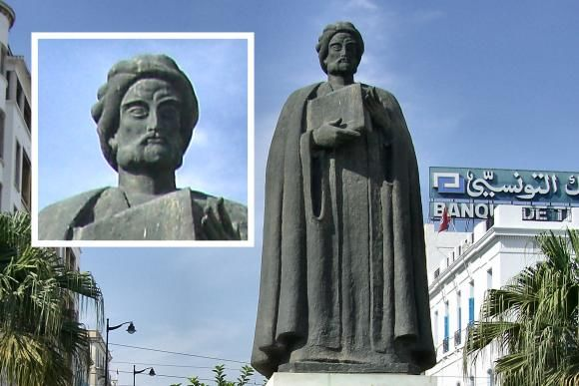
Problem 6: The Problems of the Historiographical Context
Objective: Identify “the motive forces of the historical process.”

Slide 18
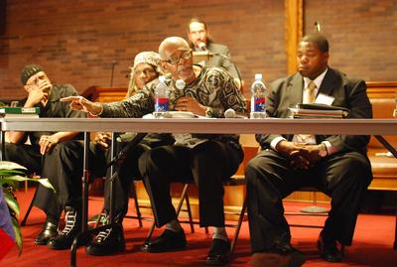
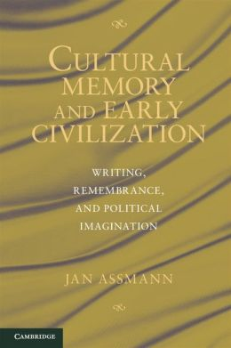
Black Study as Governance
The Assmann Thesis:
First order and second order religions
The Question of Reparations

Slide 19
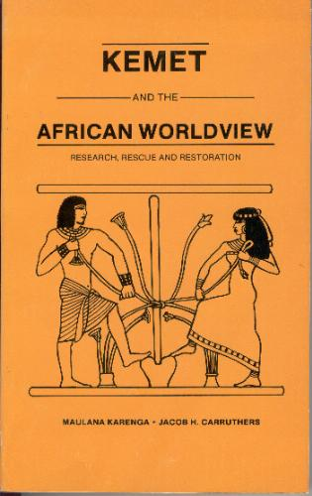
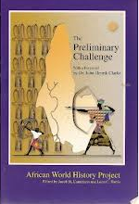
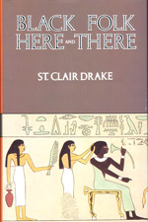
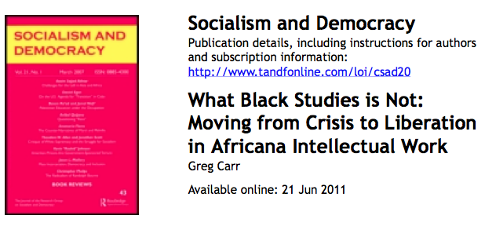
Categories and Combattants
Old Scrappers
Negro Intellectuals
Progressive Extension of Old Scrappers

Slide 20
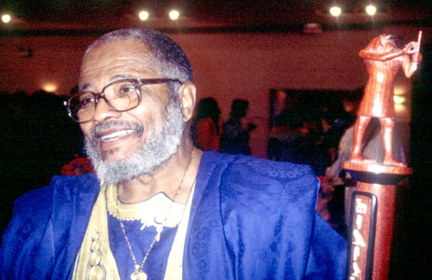
The Directives: A Sebayt
Replacing the universal evolutionary theory with the Two Cradle Theory
The development of maps with a Southern reference
The replacement of Greek and Latin with Mdw Ntr as the classical language
The development of a Kemetic calendar based upon a great event from our heritage, e.g. the unification of Tawi (the United Two Lands)
The development of a Kemetic historiography based on the normalcy of the history of peace as opposed to the abnormalcy of the history of plunder and rapine.

Slide 21
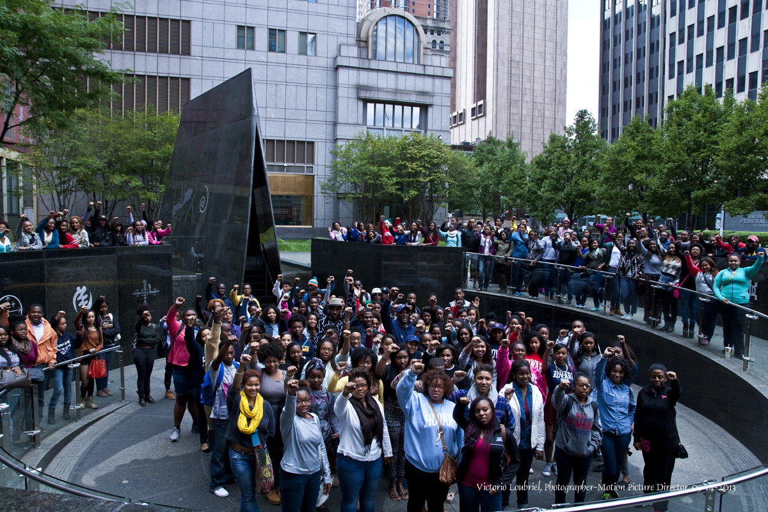
“Cherish study/avoid the dance/so you’ll become an excellent official…Write diligently by day; recite at night. Let your friends be the papyrus roll and the scribal palette; such work is sweeter than wine.” From the royal scribe (sesh nsw) Neb-Maa-Re Nakht to the scribe Wn-m-di-I Imun, 20th Kemetic dynasty, 1560s b.c.e.]

